Slide 1
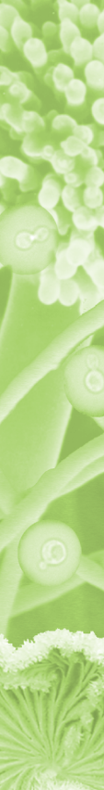

Aspergillus niger
Nature -saprotroph -opportunistic pathogen of plants and animals -benificial endophyt in grasses Human society -food spoiler -opportunistic pathogen of ginger and peanut and domestic animals -cell factory of enzymes and small molecules

Slide 2
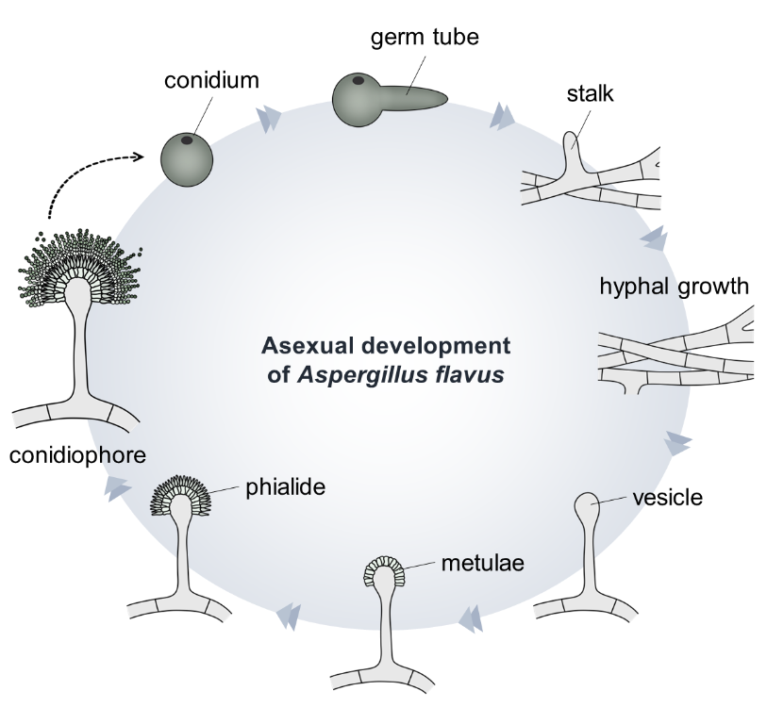
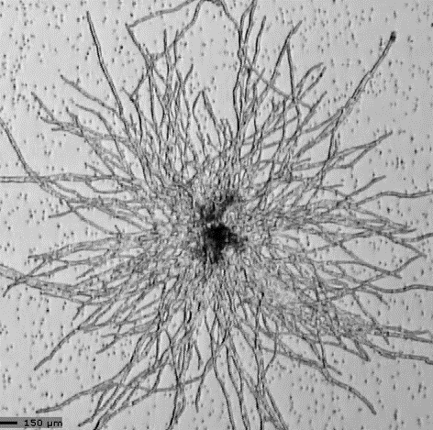
The A. niger life cycle is characterized by clonal reproduction
Cho et al., 2022. Cells 11: 2796

Slide 3
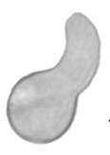
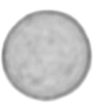

Germination of A. niger conidia is not homogenous
resting spore
low surface area
high circularity
swelling
high surface area
germ tube formation
low circularity

Slide 4
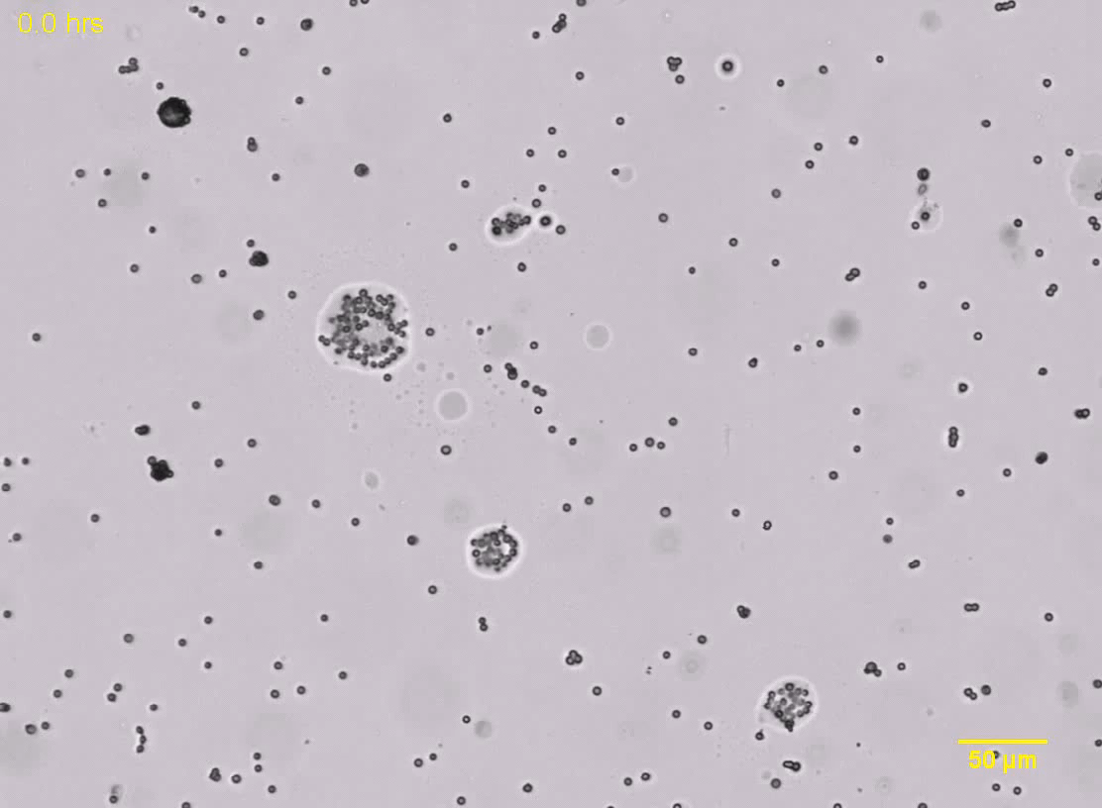

Monitoring germination of A. niger conidia
Ijadpanahsaravi et al., 2021. Fungal Biology

Slide 5
Analysis of germination of A. niger conidia
Every spore is an object with an XY coordinate, which can be followed in time
Surface area and circularity are followed in time
Maximum number of spores that swell or form germ tubes are extracted using a model (Pmax) as well as the time it takes that half Pmax is reached (Ꚍ).
Ijadpanahsaravi et al., 2021. Fungal Biology

Slide 6
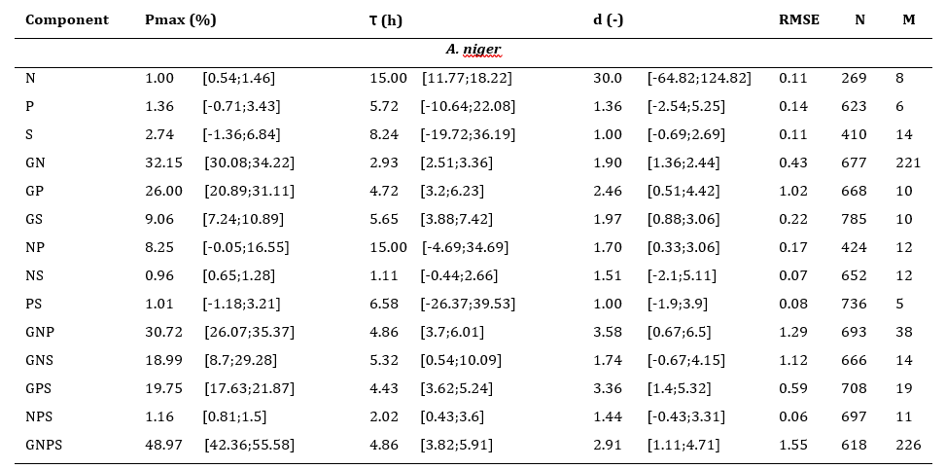
A.niger does not germinate in water but does so when exposed to an inducing carbon source with either inorganic phosphate, inorganic nitrogen or magnesium sulphate
swelling
Ijadpanahsaravi et al., 2021. Fungal Biology

Slide 7
In all cases only part of the spores germinate: a bet hedging strategy
swelling
Ijadpanahsaravi et al., 2021. Fungal Biology

Slide 8
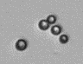
Different carbon sources have different inducing capacity
swelling
cysteine
Ijadpanahsaravi et al., 2022. Antonie van Leeuwenhoek

Slide 9
Different carbon sources have different inducing capacity in different aspergilli; thereby impacting competitiveness
swelling
Ijadpanahsaravi et al., 2022. Antonie van Leeuwenhoek

Slide 10
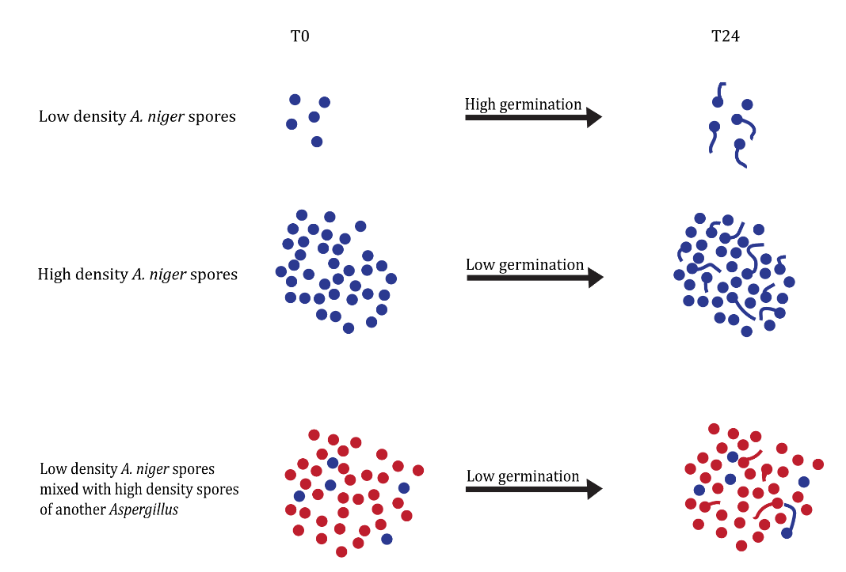
Spore density affects germination in A. niger
Ijadpanahsaravi et al., 2023. Int J Food Microbiol

Slide 11
Do also other spores of aspergilli affect germination in A. niger
Ijadpanahsaravi et al., 2023. Int J Food Microbiol

Slide 12
Spore density affects germination in A. niger

Slide 13
Can we make a model where we can interactively show what happens to the colonization of a surface
With different Pmax and t
With different density of spores
With different growth speed and branching and branching
Assuming hyphae will never grow perfectly parallel

